Slide 1
Viral genetics

Slide 2
Purpose
Generation of different strain, type, variant within a particular virus
Generation of viruses with increased or decreased pathogenic potential
Genetic and molecular basis of viral disease process
Effective diagnosis, prevention and treatment of viral infection

Slide 3
Mutations
A mutation is a change in the nucleic acid sequence of an organism.
In viruses, errors in copying the viral nucleic acid during replication cycles results in mutation.
In general, mutation rates are considerably higher in most RNA viruses than in DNA viruses. This is due to higher error rates in RNA-dependent RNA polymerases than DNA-dependent DNA polymerases.
The organism possessing a mutation is referred to a mutant. This change is based on comparison with the wild type (reference) virus.
The term “strain,” “type,” “variant,” and “mutant” are used to designate a virus that differs in certain heritable characteristics from the parental or wild-type virus.
Strain: Different lines or isolates of the same virus (e.g., from different geographical locations or patients)
Type: Different serotypes of the same virus (e.g., various antibody neutralization phenotypes)
Variant: A virus whose phenotype differs from the original wild-type strain but the genetic basis for the difference is not known

Slide 4
Mutagenesis
Spontaneous mutation - Mutation in the absence of any known mutagen. These are endogenous, being the result of DNA or RNA polymerase errors or the result of incorporation of naturally occurring tautomeric forms of nucleotides. DNA viruses are typically more genetically stable than RNA viruses
2. Induced mutation – are exogenous and derived from mutagen-treated population of the wild-type virus.
Mutagens (chemicals or radiation) are used to increase the frequency of mutants in the population that is subsequently screened by using appropriate selective pressures.
Chemical mutagens act either directly on the bases or indirectly by enhancing mispairing. Eg. nitrous acid or nitrosoguanidine. Nucleotide analogs such as 5-fluorouracil (for RNA viruses) or 5'-bromodeoxyuridine (for DNA viruses) are mutagenic only when virus replicates in their presence, because they are incorporated into the viral nucleic acid and produce mutations by miscoding during replication.
Uv radiation can induce the formation of pyrimidine dimers, ionizing radiation can damage DNA directly by breaking chemical bonds or indirectly by forming free radicals that in turn damage DNA.

Slide 5
Types of Mutations
Mutations results in change in viral phenotype (the kind of change they produce in the properties of the virus or the infection it causes) or
Viral genotype (the kind of change they produce in the viral genome)
Phenotypic change may be evidenced-
by a change in a physical characteristic of the virion,
by a change in a replicative characteristic seen during infection in cell culture, or
by a change in a pathogenic property in an infected animal

Slide 6
Phenotypic classification of mutants
1. Plaque morphology mutations: Mutants have altered morphology due to one of a variety of metabolic differences. e.g. syncytial (syn) mutants of viruses like herpesvirus, cause neighboring cells to fuse rather than undergo typical cytolytic changes.
2. Host range mutations: Mutation allows for a change in the host range of a particular virus from the original one associated with the wild type virus. This type of change is believed to have occurred with feline parvovirus, which extended its host range and became capable of infecting dogs.
3. Temperature-sensitive mutations: This includes a series of mutations that replicate under a specific range of conditions, beyond this range wild type viruses are capable of replication but the conditional is not.
Examples of conditional lethal mutants include temperature-sensitive mutants and cold-sensitive mutants.
Temperature-sensitive (ts) mutants have conditional-lethal phenotype. The ts mutants are produced by alteration in the nucleotide sequence of a gene so that the resulting protein product of the gene is unable to assume or maintain its functional configuration at the non-permissive (39℃) temperature. The protein, however, is able to assume a functional configuration at permissive temperature (32 ℃). e.g. herpesviruses, adenoviruses.

Slide 7
Genotypic Classification of Mutants
Deletion mutations: These mutants have a deletion in their genomes. e.g. psuedorabies virus gene deleted vaccine.
Point mutations: Alteration of a single nucleotide in the viral genome. This can be achieved by an in vitro mutagenesis technique.
The phenotypic expression of a mutation may be reversed not only by a back-mutation in the affected nucleotide(s) but also by a suppresser mutation occurring elsewhere in the same gene, or even in a different gene, which leads to the reappearance of the wild-type phenotype.
Mutations based on nucleotide substitutions revert most frequently, those based on small deletions or insertions less frequently, and those based on large deletions rarely if ever.

Slide 8
Defective Interfering (DIP) particles or Mutants
Defective interfering particles (DIPs), caused by the critical absence of part the viral genome, are unable to replicate on their own.
They need the presence of the parental wild-type virus; at the same time they interfere with and usually decrease the yield of the parental virus.
All DI particles of RNA viruses that have been characterized are deletion mutants.
Hepatitis delta virus or HDV is a defective virus, requires infection of the same cell with HBV, which contributes the HBsAg that HDV uses for virion assembly.

Slide 9
Antigenic shift and drift
Antigenic shift refers to the change in antigen associated with a viral pathogen due to the acquisition of a novel entire gene or a change in an existing one.
Typically antigenic shift is observed readily with those viruses that possess multipartite genomes, such orthomyxoviruses, arenaviruses and bunyaviruses.
Coinfection of different strains in the same cell may result in packaging mixed genomes, containing some segments from one virus and other from the other.
In influenza viruses, antigenic shift involves the sudden acquisition of the gene for a completely new hemagglutinin(HA) or neuraminidase (N), giving rise to a novel subtype that may spread rapidly around the world, unencumbered by any herd immunity.

Slide 10
Pig serves as a "mixing vessel"
Influenza A viruses from birds grow very poorly in humans, and vice versa.
Both avian and human influenza viruses can replicate in swine, and genetic reassortment between them occurs in host.
An antigenic shift in nature occurs when the prevailing human strain of influenza A virus and an avian influenza virus concurrently infect a pig, which serves as a "mixing vessel." Every 10-20 years a reassortant virus from the pig, containing genes encoding replicative functions from a human virus and a hemagglutinin gene derived from an avian virus, emerges.
H1N1replaced by H2N1 or H3N2

Slide 11
Antigenic drift
It is a result of accumulation of point mutations (single bases substitutions) and has been identified as the mechanism associated with the antigenic variation observed with influenza viruses and may be the mechanism associated with the variability observed with rhinoviruses.
Produce strains each antigenically slightly different from its predecessor.
In influenza viruses, mutations in the gene encoding the hemagglutinin sometimes alter its antigenic sites. When antiserum against the formerly prevalent strain no longer neutralizes the variant, a new strain has emerged.

Slide 12
S.N. | Antigenic Shift | Antigenic Drift
1 | Major Antigenic Change | Minor Antigenic Change
2 | Forming new sub-type (Subtype A + Subtype B –> New Subtype) | Forming new strain of virus
3 | One or Two Viruses are Involved | Only one virus is involve
4 | Occurs once in a time | Occurs frequently
5 | May jump from one species to another (animal-human) | May infect animals of the same species
6 | Large change in nucleotides of RNA | Small mutation of RNA
7 | Occurs as a results of genome reassortment between difference subtypes. | Occurs as a result of the accumulation of point mutations in the gene.

Slide 13
S.N. | Antigenic Shift | Antigenic Drift
8. | An antigenic change which results in drastic or dramatic alternation in HA (hemagglutinin) or NA (neuraminidase) subtypes | An antigenic change can alter antigenic sites on the molecule such that a virion can escape recognition by the host’s immune system
9 | Large and sudden mutation | Random and Spontaneous Mutation
10 | Difficult to treat (need new vaccine) | Easy to treat (antibody and drugs available)
11 | Occurs only in Influenza Virus A | Occurs in Influenza Virus A, B and C
12 | Give rise to pandemics, which occurs irregularly and unpredictably. | Usually responsible for epidemics in between pandemics

Slide 14
Genetic Interaction Between Viruses
Viral infections with two or more different viruses are known to occur in nature as well as in culture. These are referred to as mixed infections and can result in new viral combinations, and thus new variants of the virus. Some of the interactions that can occur during mixed infections are:
1. Complementation- interactions between viral proteins in doubly infected cells that result in rescue or increased yields of one or both viruses.
This can occur between two strains of the same virus, two related viruses, or two unrelated viruses while their genotypes remain unchanged.
Complementation can occur during a mixed infection when one of the two viruses is deficient in a particular gene product. Without this protein, the virus is incapable of transmission and replication and is therefore a defective particle.
In a mixed infection, if the second virus involved does make the product (thus complementing of the defect), the defective particle is capable of completing the transmission and replication processes

Slide 15
2. Genetic recombination
When two different viruses simultaneously infect the same cell, genetic recombination may occur between the nucleic acid molecules during or after their synthesis. As a result, the progeny are genetically distinct from the two "parental" viruses. Three mechanisms:
1. Intramolecular recombination
2. Copy-choice Recombination
3. Genetic reassortment
4. Genetic reactivation

Slide 16
Intramolecular recombination
Involves the exchange of nucleotide sequences between different but usually closely related viruses during replication
It occurs with all double-stranded DNA viruses, presumably because of template switching by the polymerase. Intramolecular recombination also occurs among RNA viruses (e.g., picornaviruses, coronaviruses and togaviruses)
In all DNA viruses and RNA viruses that replicate via DNA intermediates, recombination involves the breakage and reformation of covalent bonds within the nucleic acid.
Recombination between two regions on a single dsDNA molecule can result in looping out of the intermediate region, yielding a shorter dsDNA molecule and a separate circular dsDNA molecule

Slide 17
Copy-choice Recombination
A genetic recombination in which the new nucleic acid molecule comes about by replicating selected parts of each parental molecule and by alternating between the two (maternal and paternal).
Polymerase switches template strand during RNA synthesis
This mechanism is poorly understood and occurs in monopartite RNA viruses.

Slide 18
Genetic Reassortment
This occurs in mixed infections with variant viruses having segmented genomes infecting a single cell.
The progeny virions can contain some segments from one parent, some from the other.
This is an efficient process observed with orthomyxoviruses, reoviruses, arenaviruses, and bunyaviruses.
Reassortment has been implicated in the appearance of new, highly virulent influenza virus strains throughout the 20th century.

Slide 19
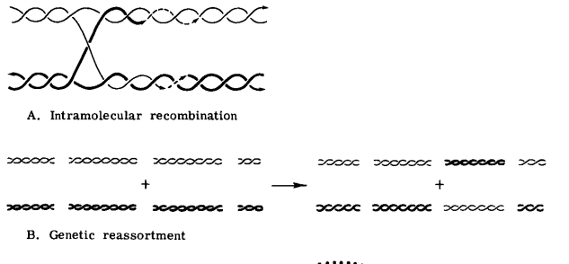

Slide 20
Genetic Reactivation
Genetic reactivation is a special case recombination/reassortment that occurs in mixed infections when one or both of the viruses is non-infectious.
The progeny, resulting from either recombination or reassortment, are now infectious and carry markers of both parents.
If only one parent was non-infectious, the process is called cross-reactivation or marker rescue.
If both parents were non-infectious, the process is called multiplicity reactivation.

Slide 21
Genotypic mixing
This is the incorporation of more than one complete genome into the same virus capsid.
If the genomes are from the same virus species, the phenomenon is polyploidy;
if the genomes are from different virus species, the phenomenon is heteropolyploidy or genotypic mixing.
There is no recombination between the genomes and cells singly infected with the genotypically mixed viruses will yield progeny identical to both original parents as well as more genotypically mixed viruses.

Slide 22
Phenotypic mixing
A process by which individual progeny of a mixed infection contains structural proteins (capsid or envelope) derived from both parental viruses.
Phenotypic mixing is an example of non-genetic interactions between two viruses.
A progeny genome identical to one parent is enclosed within a capsid or envelope entirely specified by the other parent and it is referred to as pseudotype formation or the envelopes of some of the progeny particles display antigens derived from both parents.
With nonenveloped viruses, phenotypic mixing can take the form of transcapsidation, in which there is partial or usually complete exchange of capsids . For example, poliovirus nucleic acid may be enclosed within a coxsackievirus capsid, or adenovirus 7 genome may be enclosed within an adenovirus 2 capsid.

Slide 23
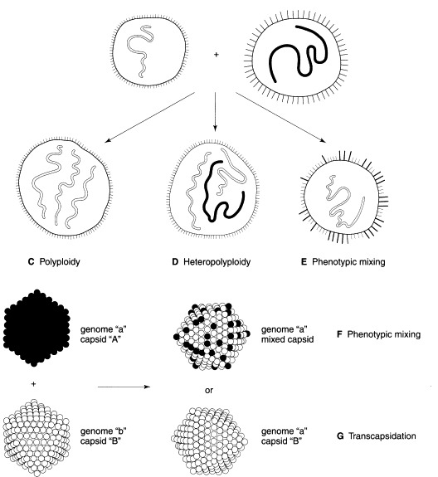

Slide 24
VIRUS -CELL INTERACTIONS
The range of changes induced in more than 200 different kinds of cells in the typical animal host by different viruses is remarkably diverse.
Disruption of cellular function
Induction of cell death
Transformation
Activation of an inappropriate immune response
These changes are manifested as disease.

Slide 25
Types of Virus-Cell Interations
Cytolytic or cytocidal infection – Cell die
Non-cytolytic infection – Cell remain intact
Productive Infections – Virus replicates and fully infectious virions are poroduced
Non productive Infections/ abortive infections – Virus replicate inside the cell but defective virus or incomplete progeny is produced. Infections of non-permissive cells yield no infectious progeny virus
Permissive cells – They support the complete replication of viruses
Non permissive cells – Not allow the replication of virus. viral replication may be blocked at any point from viral attachment through to the final stages of virion assembly and release.

Slide 26
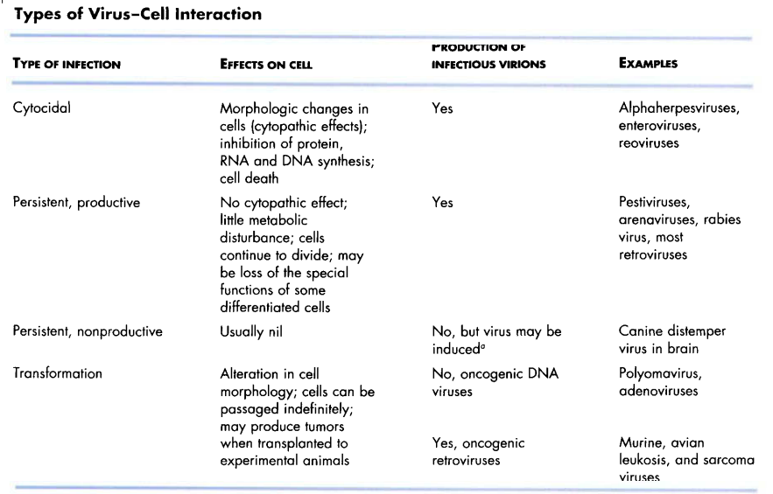

Slide 27
Cytocidal changes in virus-infected cells
Cytopathic viruses kill the cells in which they replicate and leads to cell damage.
Morphological changes in cells caused by viral infection are called cytopathic effects (CPE); the responsible virus is said to be cytopathogenic.
CPE can usually be observed by low-power light microscopy of unstained cell cultures.
The microscopic appearance of the CPE caused by some of these cytocidal viruses may be sufficiently characteristic to allow provisional identification of an unknown virus.
Cytopathic effect is often characteristic of the particular virus involved

Slide 28
Mechanisms of Cell Damage
Inhibition of Host Cell Nucleic Acid Synthesis
Inhibition of Host Cell RNA Transcription
Inhibition of Processing of Host Cell mRNAs
Inhibition of Host Cell Protein Synthesis
Inviting immune cells

Slide 29
Inhibition of Host Cell Nucleic Acid Synthesis
Common in viral infections.
It is an inevitable consequence of viral inhibition of host cell protein synthesis
Eg. poxviruses produce a DNAse that degrades cellular DNA,
Herpes viruses specifically displace the synthesis of host cell DNA with their own synthetic processes.

Slide 30
Inhibition of Host Cell RNA Transcription
Poxviruses, rhabdoviruses, reoviruses, paramyxoviruses, and picornaviruses, inhibit host cell RNA transcription.
May be indirect consequence of viral effects on host cell protein synthesis which decrease availability of transcription factors required for RNA polymerase activity
Viruses encode specific transcription factors for the purpose of regulating the expression of their own genes and, in some instances, these factors modulate the expression of cellular genes as well
Eg. herpesviruses encode proteins that bind directly to specific viral DNA sequences, thereby regulating the transcription of viral genes.

Slide 31
Inhibition of Processing of Host Cell mRNAs
Interference with the splicing of cellular primary mRNA transcripts
Ex. vesicular stomatitis viruses, influenza viruses, and herpesviruses.
Spliceosomes are formed, but subsequent catalytic steps are inhibited. Spliceosomes are complexes composed of small nuclear RNA (snRNA) that remove introns in protein-encoding genes (splicing)
Eg: a protein synthesized in herpesvirus- infected cells suppresses RNA splicing and leads to reduced amounts of cellular mRNAs and the accumulation of primary mRNA transcripts.

Slide 32
Inhibition of Host Cell Protein Synthesis
The shutdown of host cell protein synthesis, while viral protein synthesis continues, is a characteristic of many virus infections.
Eg. Picorna virus, togavirus, influenzavirus, rhabdovirus, poxvirus, and herpesvirus infections.
Mechanisms :
viral enzymes degrade cellular mRNAs
Factors that bind to ribosomes and inhibit cellular mRNA translation
alteration of the intracellular environment favouring the translation of viral mRNAs .
Viral proteins may also inhibit the processing and transport of cellular proteins from the endoplasmic reticulum, and this inhibition may lead to their degradation. Ex. lentiviruses

Slide 33
Inviting immune cells
Virus infect healthy cells
During replication of virus some viral protein leaks
Leaked protein attach to the cell membrane
Natural Killer cells detect that protein in abnormal cells
Perforin released by killer cells and make hole in mb
Cytoplasm will come out and cell dies

Slide 34
Cytopathic Changes Involving Cell Membranes
Viruses may alter plasma membrane permeability,
affect ion exchange and membrane potential,
induce the synthesis of new intracellular membranes, and
induce the rearrangement of previously existing membranes.
Enveloped viruses also direct the insertion of their surface glycoproteins, including fusion proteins, into host cell membranes as part of their budding process, often leading to membrane fusion and syncytium formation.

Slide 35
Cell Membrane Fusion and Syncytium Formation
Infection of cell monolayers by lentiviruses, paramyxoviruses, morbilliviruses, pneumoviruses, some herpesviruses, and some other viruses is the production of syncytia which result from the fusion of an infected cell with neighbouring infected or uninfected cells.
Such multinucleate syncytia may also be seen in the tissues of animals infected with these viruses
Such syncytia may represent an important mechanism of viral spread in tissues: fusion bridges may allow subviral entities, such as viral nucleocapsids and nucleic acids, to spread while escaping the effects of host defenses.

Slide 36
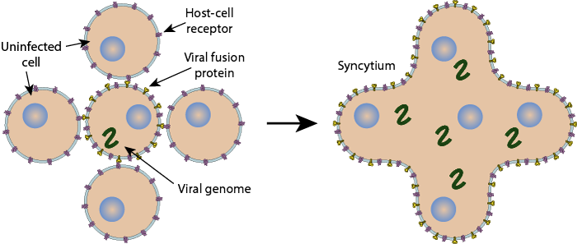

Slide 37
Hemadsorption
Infective cell produce some proteins which have the ability to adsorb erythrocytes phenomenon known as Haemadsorption .
Incorporation of viral glycoprotein peplomers into the plasma membrane of infected cells where they serve as receptors for ligands on the surface of erythrocytes. Eg. orthomyxoviruses, paramyxoviruses, and togaviruses,

Slide 38
Haemagglutination
Glycoprotein peplomers (enveloped virus) are responsible for hemagglutination, in vitro, i.e., the agglutination of erythrocytes.
Virions added to an erythrocyte suspension form cell-virus-cell bridges involving large numbers of erythrocytes.
Both phenomena are used extensively in laboratory diagnostics
Haemadsorption – by Infected host cell ´ Haemagglutination – by virus

Slide 39
Cytopathic Changes Involving the Cytoskeleton
The cytoskeleton is responsible for the structural integrity of the cell, for the transport of organelles through the cell, and for certain cell motility activities.
Damage to the cytoskeleton results in changes in cell shape
Particular viruses are known to damage specific filament systems.
Canine distemper virus, vesicular stomatitis viruses, vaccinia virus depolymerization of actin-containing microfilaments
Enteroviruses -----extensive damage to microtubules

Slide 40
Non-cytocidal Changes in Virus-Infected Cells
Non-cytocidal viruses usually do not kill the cells in which they replicate.
Infected cells even continue to grow and divide.
Found in cells infected with several kinds of RNA viruses: pestiviruses, arenaviruses, retroviruses, and some paramyxoviruses.
Persistent infection
Inclusion bodies
Cell transformation

Slide 41
Persistent infections
Non-productive virus cell interactions
The term persistent infection simply describes an infection that lasts a long time.
The term latent infection describes an infection that "exists but is not exhibited," i.e., an infection in which infectious virions are not formed.
In either case, the virus or its genome is maintained indefinitely in the cell, either by the integration of the viral nucleic acid into the host cell DNA or by carriage of the viral nucleic acid in the form of an episome

Slide 42
Inclusion bodies
Inclusion bodies are aggregates of virus particles or virus-induced proteins or special structures characteristic of infection or degenerative cellular changes by viruses either in the cytoplasm or the nucleus.
Intranuclear/ Intracytoplasmic, also found both
single / multiple, Large/ small, round/ irregular in shape
Acidophilic (pink, stained by eosin) or basophilic (blue, stained by hematoxylin).
Intracytoplasmic Inclusion bodies – Pox virus, Reovirus, Paramyxo virus and Rabies virus
Intranuclear Inclusion bodies – Herpes virus, Adeno virus and Parvo virus
Both IB – Canine distemper virus and porcine cytomegalo virus

Slide 43
Examples of viral inclusion bodies in animals
Cytoplasmic eosinophilic (acidophilic)-
Downie bodies in cowpox
Negri bodies in rabies
Guarnieri bodies in vaccinia, variola (smallpox)
Paschen bodies in variola (smallpox)
Bollinger bodies in fowlpox
Nuclear eosinophilic (acidophilic)-
Cowdry bodies type A in Herpes simplex virus and Varicella zoster virus
Torres bodies in yellow fever
Cowdry bodies type B in polio and adenovirus
Nuclear basophilic-
Cowdry bodies type B in adenovirus
"Owl's eye appearance" in cytomegalovirus

Slide 44
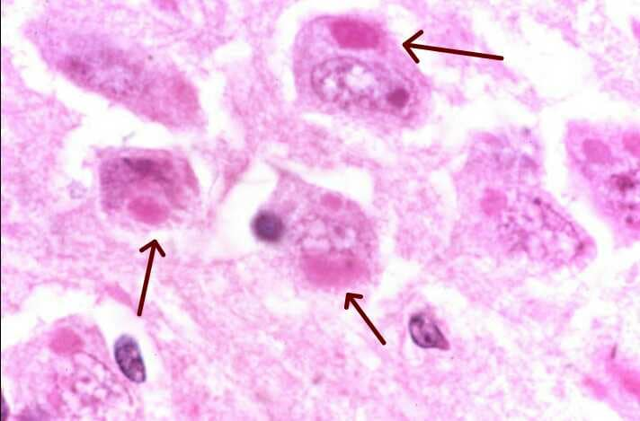
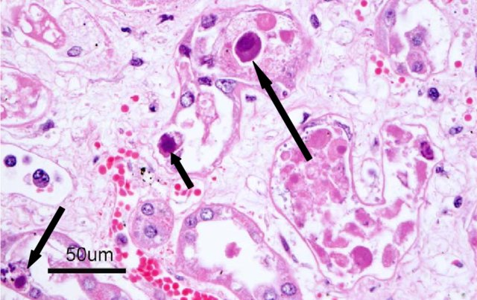
Negri body
Cowdry A

Slide 45
Ultrastructural Changes in Virus-Infected Cells
Specific and nonspecific changes in virus infected cells that may vary.
Specific changes-
Early changes in cell structure often are dominated by proliferation (herpes viruses cause increased synthesis or reduplication, of nuclear membranes)
Disruption of cytoskeletal elements, mitochondrial damage, and changes in the density of the cytosol.
Many cytolytic viruses cause nuclear, organelle, and cytoplasmic rarefaction and/or condensation, with terminal loss of host cell membrane integrity.

Slide 46
Non-specific changes
Cloudy swelling- a reversible pathological change associated with increasing permeability of the plasma membrane resulting in diffuse swelling of the nucleus, distention of the endoplasmic reticulum and mitochondria, and rarefaction of the cytoplasm.
Cell destruction can be the consequence of further loss of osmotic integrity and leakage of lysosomal enzymes into the cytoplasm. This progression, overall, is called the common terminal pathway to cell death.

Slide 47
Virus-Induced Cell Death
By triggering cellular "suicide," or programmed cell death or apoptosis.
By chromatin condensation and margination and activation of cellular endonuclease during apoptosis that cleaves cellular DNA (not seen in necrosis).
Some viruses induce apoptosis by the direct action of a specific protein--adenoviruses, alphaviruses, and the circovirus, chicken anemia virus, have proteins that by themselves are sufficient to induce apoptotic cell death.
Or indirectly through their effects on cellular processes.
Some viruses have acquired one or more anti-apoptotic genes and gene products to prolong cell survival

